Slide 1
Sekuri-Talk Website
Zachary Michniewicz, Yash Thakor & Vikas Rana

Slide 2
Agenda
Sekuri-Talk Overview
Actors
Use Cases
Register
View World Heatmap
Reset Password
Update Information
Use Case Diagram
Prototype Demo
Contributions

Slide 3
Website Overview
Sekuri-Talk will gather and display information about all things cyber-security.
It can be used by Hobbyists, Journalists, Influencers, and many more to collect data to use in their own beneficial way.
Sekuri-Talk users will be able to search hashtags, accounts, and even images collected and curated from the social media platform Twitter.

Slide 4
Actors
Only one actor
User
All theorized end users had the same features

Slide 5
Use Cases

Slide 6
Register (Author: Yash)
Description:
User is able to register an account for the website, which is required to view any content.
Success Scenario:
User visits Sekuri-Talk website and indicates that they want to register
System displays register page
User enters details (name, email, username, password, etc…) and presses the register button
System verifies the details (username is unique, email exists, password is strong, etc…)
User is successfully registered
Alternate Flows:
3a1. User does not enter details
User presses register button
System will check for input and notify user to enter details
Use case resumes at step #3 in success scenario
3a2. User enters wrong details
User presses register button
System verifies details and prompts user (Invalid Username/Password)
Use case resumes at step #3 in success scenario

Slide 7
View World Heatmap (Author: Zach)
Description:
User is able to view a heatmap of the world of the number of tweets for a given hashtag.
Success Scenario:
User presses trends button
System shows options to choose within trends
User presses World Heatmap
System displays start date and end date for user to choose
User selects dates on the calendar
System checks for valid date (before Twitter was created)
System displays a heatmap of the number of tweets posted across the world from within the timeframe
Alternate Flows:
4A1. User selects invalid dates
System displays a message informing the user that the dates are invalid
Use case resumes at step 4 of success scenario

Slide 8
Reset Password (Author: Vikas)
Description:
User is able to reset the password of their account when not able to login.
Success Scenario:
user select the “ forgot password" button
system will ask user to send one time password to email or phone number
user will select the option phone number
system will show the phone number in “*” format only last four digits are being shown
user will select send code option
system will send one time password to the user
user will submit the one time password
system will verify and ask user to create new password
The user will enter a new password .
Alternate Flows:
user does not have the correct code to verify
system will ask user to enter correct code
user enter correct code
system verifies the code
user will enter new password
system updates the password

Slide 9
Update Information (Author: Vikas)
Description:
User is able to update the personal information stored in their account.
Success Scenario:
user will hit the button update information
user will change the phone number
user will change the email address
user will change the adress
user will hit the save button
system will save the response and update the information .
Alternate Flows:
user will hit the button update information
user will change the phone number and other information
system will show the box if each and every information was same as before
user will enter new information
user will hit the save button

Slide 10
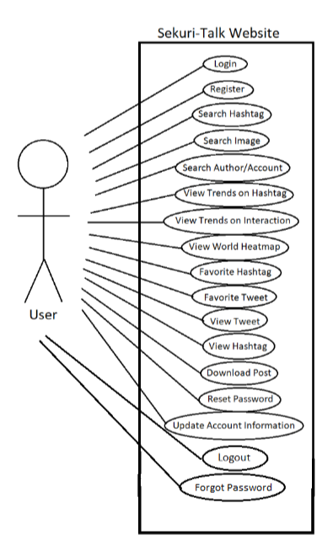
Use Case Diagram

Slide 11
Prototype Link
https://www.figma.com/file/UoIwHzsYVzbl6tRDzs8mJC/Sekuri-Talk?node-id=0%3A1&t=xYUPYjmMiFq2jGps-1

Slide 12
Contributions
Use Cases – Zach Michniewicz, Yash Thakor, and Vikas Rana
Presentation – Zach Michniewicz, Yash Thakor, and Vikas Rana
Prototype – Zach Michniewicz, Yash Thakor, and Vikas Rana

